Slide 1
SVCC Special Meeting
October 19, 2025

Slide 2
Agenda
Introductions
SVCC Financials August 2025
Historical Cash Flow
Course Update
Grant Improvements to Grounds
Land Sales
Member Questions and Comments

Slide 3
SVCC Financial Information | Thru August |  | Thru August |  | Thru August |  |  | Thru August |  | Thru August |  | Thru August
Revenue | 2025 Actual |  | Budget |  | 2024 Actual |  | Expenses | 2025 Actual |  | Budget |  | 2024 Actual
Golf Dues | $168,414 |  | $157,460 |  | $271,562 |  | Golf Course Payroll | $112,435 |  | $111,927 |  | $117,097
Greens Fees | $105,268 |  | $104,650 |  | $96,487 |  | Pro Shop Payroll | $42,780 |  | $36,923 |  | $40,887
Cart Rentals | $111,522 |  | $105,621 |  | $91,645 |  | Payroll Taxes | $22,445 |  | $20,690 |  | $21,512
Other Golf revenue | $69,726 |  | $65,714 |  | $74,840 |  | Fertilizer,Chemicals, | $51,222 |  | $86,000 |  | $55,274
Total Golf Revenue | $454,929 |  | $433,445 |  | $534,534 |  | Other Course & Pro shop expenses | $126,438 |  | $158,062 |  | $96,954
 |  |  |  |  |  |  | Total Course and Pro shop expenses | $355,320 |  | $413,602 |  | $331,724
Event food sales | $121,645 |  | $99,095 |  | $109,706 |  | Event Wages | $48,949 |  | $55,722 |  | $50,158
Beverage sales | $122,306 |  | $124,910 |  | $117,836 |  | House Wages | $35,454 |  | $20,906 |  | $45,540
Other House sales | $81,646 |  | $76,947 |  | $20,433 |  | Maint & clean Wages | $14,643 |  | $15,373 |  | $15,896
Total House Revenue | $325,597 |  | $300,952 |  | $247,975 |  | Payroll Taxes | $16,768 |  | $15,117 |  | $20,957
 |  |  |  |  |  |  | Beverage Expense | $54,860 |  | $41,097 |  | $45,063
Pool Dues | $44,184 |  | $60,000 |  | $49,207 |  | Catering Food Expense | $81,845 |  | $73,115 |  | $65,412
Other Pool Revenue | $1,584 |  | $4,450 |  | $3,373 |  | Other House Expenses | $33,647 |  | $24,288 |  | $32,972
Total Pool Revenue | $45,768 |  | $64,450 |  | $52,580 |  | Total House Expenses | $286,166 |  | $245,618 |  | $275,998
Assessment | $0 |  | $0 |  | $42,600 |  | Pool Wages | $10,197 |  | $11,500 |  | $13,028
ERTC revenue | $137,281 |  | $137,279 |  | $37,837 |  | Payroll Taxes | $2,086 |  | $2,490 |  | $2,746
Other revenue | $8,442 |  | $8,452 |  | $3,120 |  | Pool Chemicals | $12,423 |  | $11,000 |  | $9,372
Total Other income | $145,723 |  | $145,731 |  | $83,557 |  | Maintenance & Repair | $6,239 |  | $4,000 |  | $3,120
 |  |  |  |  |  |  | Other Pool Expenses | $6,536 |  | $6,843 |  | $4,609
Total revenue | $972,018 |  | $944,579 |  | $918,646 |  | Total Pool Expenses | $37,481 |  | $35,833 |  | $32,875
Income over expenses | $13,983 |  | -$753 |  | $10,058 |  | Office Wages | $40,945 |  | $36,845 |  | $48,846
Depreciation Expense included | $52,400 |  | 52400 |  | $52,400 |  | Office Payroll Taxes | $5,472 |  | $7,745 |  | $6,786
Member Contributions | $15,925 |  | 7500 |  | $9,041 |  | Bank and Credit card Fees | $11,962 |  | $11,120 |  | $10,879
Sale of Assets ( Land + Golf Cart) | $75,737 |  | 77500 |  | $4,043 |  | Insurance | $50,161 |  | $53,628 |  | $43,049
 |  |  |  |  |  |  | Interest | $13,577 |  | $14,026 |  | $18,305
Cash Flow from Current Year Operations | $158,045 |  | $136,647 |  | $75,542 |  | Gas | $13,408 |  | $7,187 |  | $9,647
 |  |  |  |  |  |  | Electric | $24,456 |  | $21,543 |  | $17,191
 |  |  |  |  |  |  | Sewer | $16,000 |  | $13,200 |  | $16,000
 |  |  |  |  |  |  | Real Estate Taxes | $12,003 |  | $14,680 |  | $17,481
 |  |  |  |  |  |  | Other Expenses | $83,734 |  | $62,956 |  | $72,807
 |  |  |  |  |  |  | Total Administrative expenses | $271,718 |  | $242,929 |  | $260,991
Fixed Assets of SVCC | $5,238,101 |  |  |  | $5,209,190
Annual Additions to Fixed Assets of SVCC | $28,911 |  |  |  | $5,119 |  | Fireworks Expense | $7,350 |  | $7,350 |  | $7,000
Accounts Payable | $170,674 |  |  |  | $185,836
Line of Credit+ Equipment loans or leases | $280,651 |  |  |  | $457,035 |  | Total SVCC Expenses | $958,035 |  | $945,331 |  | $908,588

Slide 4
Susquehanna Valley Country Club | Actual | Actual | Actual | Actual
Financial Information Annual Meeting 4/2025 | 2021 | 2022 | 2023 | 2024
Golf course & pro shop expenses | $487,595 | $588,817 | $656,365 | $528,421
Golf course & pro shop revenue | $330,081 | $320,632 | $331,967 | $334,462
Golf course & pro shop income or (expenses) | -$157,514 | -$268,185 | -$324,398 | -$193,959
Food & Beverage & Wages expenses | $289,586 | $661,250 | $623,767 | $406,632
Food & Beverage revenue | $249,613 | $626,462 | $618,674 | $396,530
F&B income or (expenses) | -$39,973 | -$34,788 | -$5,093 | -$10,102
Pool Expenses | $40,178 | $50,397 | $55,816 | $45,401
Administrative Expenses | $201,402 | $231,074 | $215,786 | $267,820
Property Expenses | $130,608 | $156,220 | $110,244 | $141,740
Entertainment Expenses | $13,125 | $16,050 | $9,600 | $11,450
Other Various Income | $9,106 | $3,249 | $4,035 | $46,355
Total Club Expenses Above | $1,162,494 | $1,703,808 | $1,671,578 | $1,401,465
Total Club expenses not covered by revenue above | $573,694 | $753,465 | $716,902 | $624,118
Dues Revenue | $468,736 | $480,605 | $474,320 | $465,286
Assessment | $79,337 | $8,167 | $0 | $42,600
Overall Shortage of revenue from operations | $25,621 | $264,693 | $242,582 | $116,232
Depreciation expense included in above numbers | $82,255 | $106,998 | $131,606 | $78,600
Member Contributions | $52,168 | $48,270 | $49,370 | $32,544
Sale of assets (Land and Golf Carts) | $0 | $437,194 | $18,400 | $0
Cash Flow from current year operations | $108,802 | $327,769 | -$61,607 | -$5,088
Fixed Assets of SVCC | $4,805,899 | $5,134,688 | $5,204,471 | $5,234,147
Annual additions to Fixed Assets of SVCC | $167,368 | $328,789 | $69,783 | $29,675
Accounts Payable | $55,016 | $56,567 | $138,414 | $167,975
Line of Credit + Equipment loans or leases | $314,940 | $292,906 | $468,640 | $428,451
Commercial Loan balance at end of year | $123,394 | $4,294 | $3,870 | $3,316

Slide 5
Membership
SVCC | Actual | Actual | Actual | Actual | Actual
 | 2021 | 2022 | 2023 | 2024 | 2025
Golf Members | 197 | 160 | 136 | 121 | 164*
Social Members | 36 | 30 | 44
Pool Members | 58 | 63 | 50 | 93 | 159
*34 High School and College Members

Slide 6
Course Update
The stump grinding, topsoil and seeding project
Root pruning, fill trenches and seeding on the back nine
Seeding rough on the right side of number 4
Removed multiple downed trees
Punched and top-dressed all greens 2x
Aerified and top-dressed the approaches of greens
Punched tees and seeded
Fairways and tees to be aerified starting October 22

Slide 7
Course Update
Upcoming
Conservation Grant improvements to begin in the Spring
Drill and Fill program scheduled for 6 greens on the back nine
Possible XGD drainage system for number 17

Slide 8
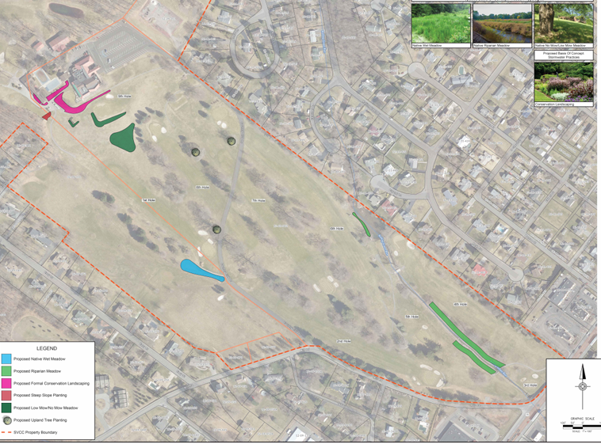
Grant Improvements to Grounds

Slide 9
Land Sales Update
Land sale and lease back completed @ $75,000
Land sales 6 lots on Mill St. @ $45,000 = $270,000
Use of Sales (sewer flow meter installation estimate $25,000, Recent repairs to Irrigation system and Drinking water wells estimate $45,000, Balance to reduce Accounts Payable and Line of Credit)

Slide 10
Interim Manager’s Observations

Slide 11
Member Comments and Questions

Slide 12
Thank you

